Slide 1
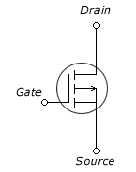







1. Block diagram
Power Block
DC Jack
DC Jack
DUT Side
Power side
Storage
UART
PWR_ON
SPI
SPI
SD Card
74LVC244
DUT TX
UART_RX
Control Module block
To DUT
UART_TX
To PC
Arduino Uno R3
Display block
LEDX4 :
12V detecting (blue) 2EA
PASS (GRN)
ERROR (RED)
Keys x 2
ATMEGA328
ATMEGA16U
UART
SPI
Pin header x 2
MC2003
7-SEG
LED
7-SEG

Slide 2
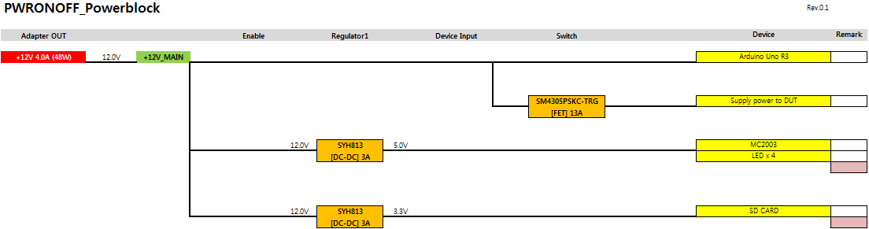
2. POWER BUDGET

